Slide 1

GPA Calculator
by John Abernathy, Jeffrey Lin, Bogac Sabuncu,
Illya Sigov
EC327: Introduction to Software Engineering

Slide 2

Overview
GPA calculator is a productivity app that allows the user to see their progress in the semester. Using course-hours, percent of grades, we created an algorithm to calculate the user’s current GPA. It will allow the user to know what classes they have to work harder on and which classes they are succeeding in.

Slide 3
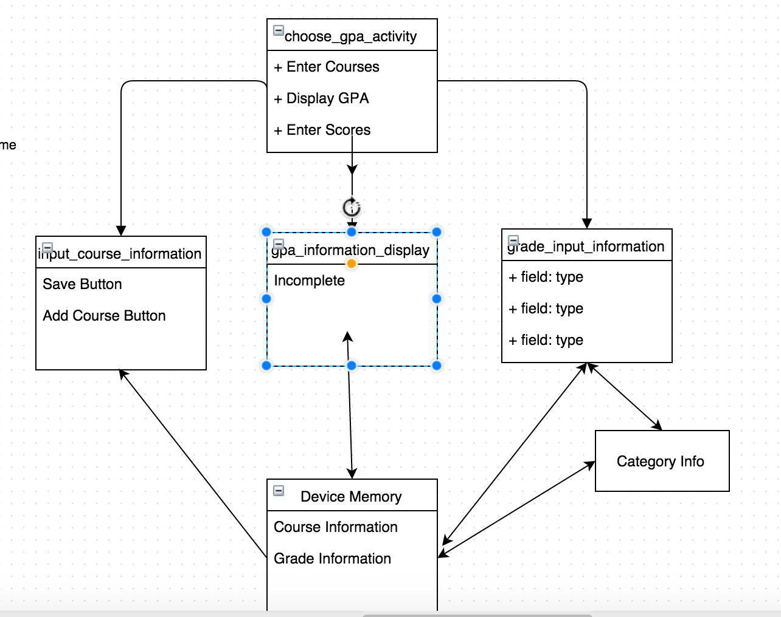
Class

Slide 4
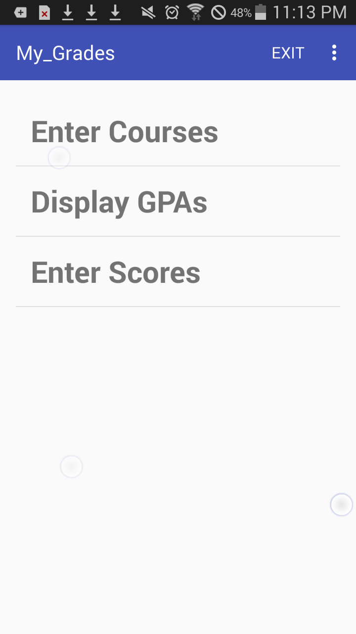
Home Screen
This home screen acts as the base screen for the app. From this screen, we are able to access the other screens to input necessary data and view results.

Slide 5
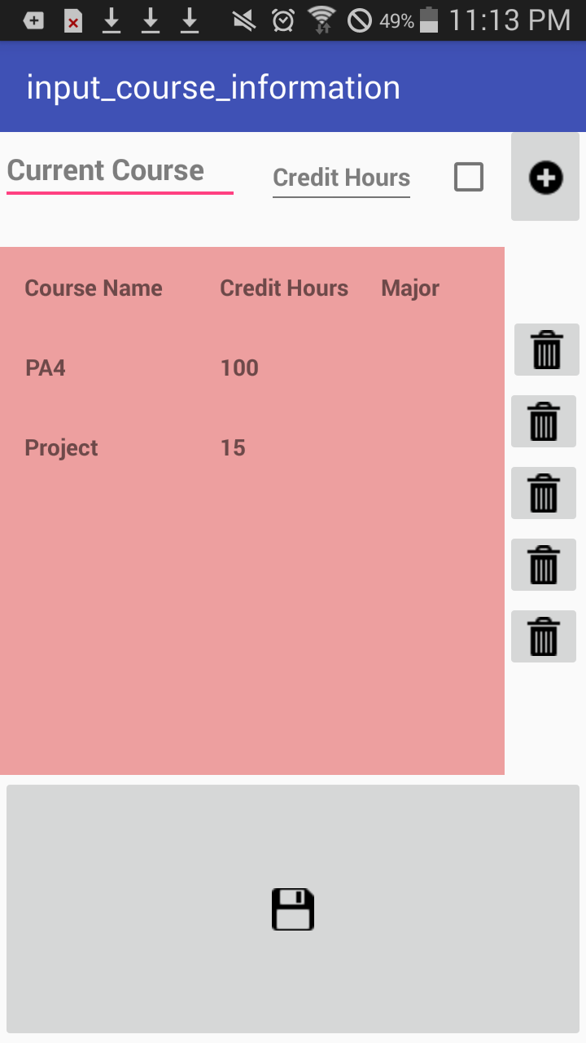
Course Input
Add Course
Enter Course Name, Number of Credits and whether or not it is a part of your major.
Delete Course

Slide 6
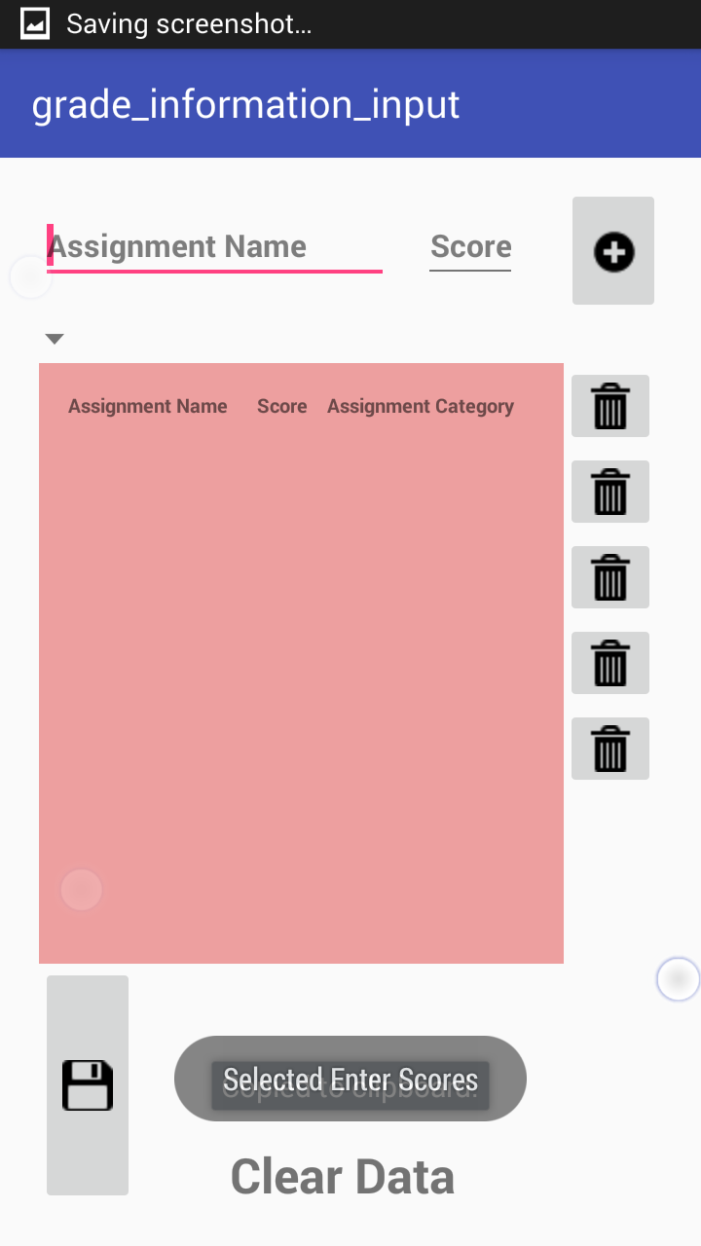
Grade Input
Enter assignment name along with the score of the course inputted. The plus sign will add items to the list and the trash can will remove them. Save icon will save data.

Slide 7
Calculate Your GPA
Today !

